Slide 1

sahayak
Made by :- j coders
Sk. Arshad akhtar
Sumeet nayak
Nishikanta ray

Slide 2
Requirements
Network
Css, html , js , php
People's participation

Slide 3
Covid 19 problem
India, with a population of over 1.3 billion, has seen troublesome growth in covid 19 cases in the past two months . When people are quarantined , they need to be taken care of, and feeding them and keeping them healthy is the most important .The problem arises with tackling the situation accordingly as It is unable to provide access to food to a large number of people . This is where Sahayak lends its helping hand .

Slide 4
What it is :-
Sahayak is basically a webapp that brings useless food to use of welfare . It is built on js, css, html as a website for anyone to access to donate food . It works by collecting food from people or ngos and distributes to covid19 struck areas .
It works 24*7 , and is totally easy to access for a comman man. Just contact us that you want t donate food and it will be collected and delivered .

Slide 5
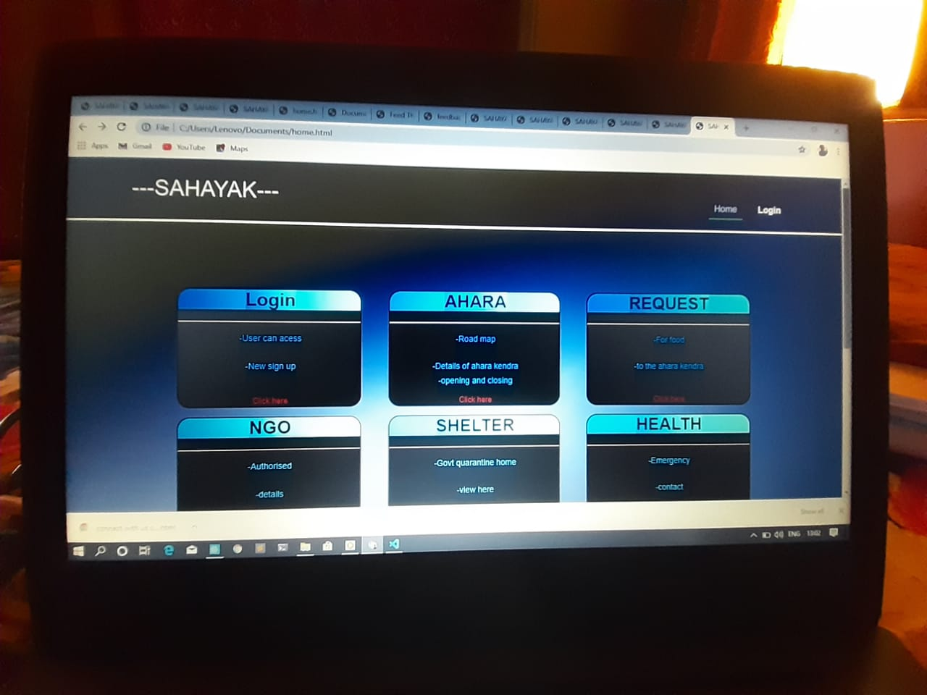
Sahayak homepage

Slide 6
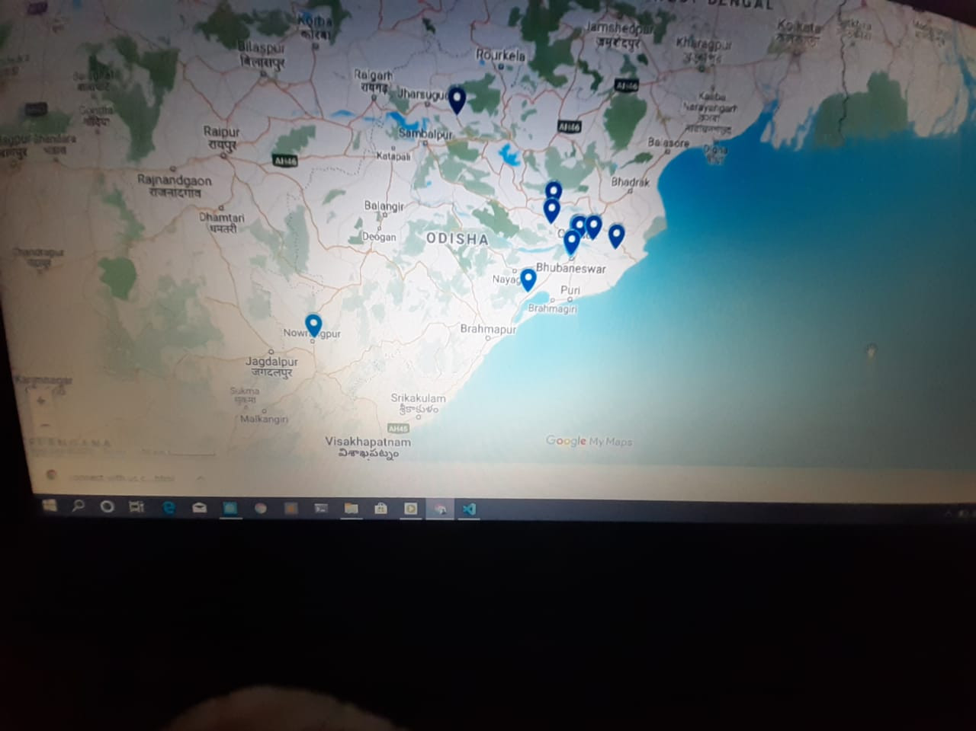
Maps showing covid19 zones

Slide 7

Digital Communications
Access Sahayak
Call @123456
Donate personally

Slide 8

Thank You
someone@example.com

